Slide 1
GROUP

Slide 2
Definition of Group
A group is a collection of individuals who interact with each other such that
one person’s actions have an impact on the others. In other words, a group is
defined as two or more individuals, interacting and interdependent, who have
come together to achieve particular objectives. Group can be defined as a
collection of individuals who have regular contact and frequent interaction,
mutual influence, the common feeling of camaraderie, and who work together
to achieve a common set of goals.

Slide 3
Types of Groups
Formal Groups :Formal groups are created to achieve specific organizational objectives. Usually, they are concerned with the coordination of work activities. People are brought together based on different roles within the structure of the organization. The nature of the task to be undertaken is a predominant feature of the formal groups. Goals are identified by management and short and rules relationships and norms of behavior established. Formal groups chain to be related to permanent although there may be changes in actual membership. However temporary formal groups may also be created by management, such as project teams in a matrix organization.

Slide 4
Informal Groups :Within the formal structure of the organization, there will always be an informal structure. The formal structure of the organization and system of role relationship, rule, and procedures, will be augmented by interpretation and development at the informal level. Informal groups are based more on personal relationships and agreement of group’s members than on defined role relationships. They serve to Satisfy psychological and social needs not related necessarily to the tasks to be undertaken.

Slide 5
Managed Group :Groups may be formed under a named manager, even though they may not necessarily work together with a great deal. They have the main thing in common, at least the manager and perhaps a similar type of work.
Semi-Formal Groups :Many groups act with less formality, in particular where power is distributed across the group, forcing a more collaborative approach that includes- negotiation rather than command and control. Families, communities and tribal groups often act as semi-formal ways as they both have nominal leaders yet members can have a high degree of autonomy.

Slide 6
Goal Group :The goal group acts together to achieve a shared objective or desired outcome. Unlike the process groups, there is no clear instruction on how they should achieve this, although they may use some processes and methods along the way. As there is no detailed instruction, the members of the goal group need to bring more intelligence, knowledge, and experience to the task.

Slide 7
Learning Group :The learning group comes together to increase their net knowledge. They may act collaboratively with discussion and exploration, or they may be taught with a teacher and a syllabus.
Problem-Solving Group :Problem-solving groups come together to address issues that have arisen. They have a common purpose in understanding and resolving their issue, although their different perspectives can lead to particular disagreements. Problem-solving may range along a spectrum from highly logical and deterministic, to uncertain and dynamic situations there creativity and instinct may be better ways of resolving the situation.

Slide 8
Friendship Group :Groups often develop because individual members have one or more common characteristics. We call these formations of friendship groups. Social alliances, which frequently extend outside the work situation, can be based on similar age or ethnic heritage, support for Kolkata Knight Riders cricket, or the holding of similar political views, to name just a few such characteristics.

Slide 9
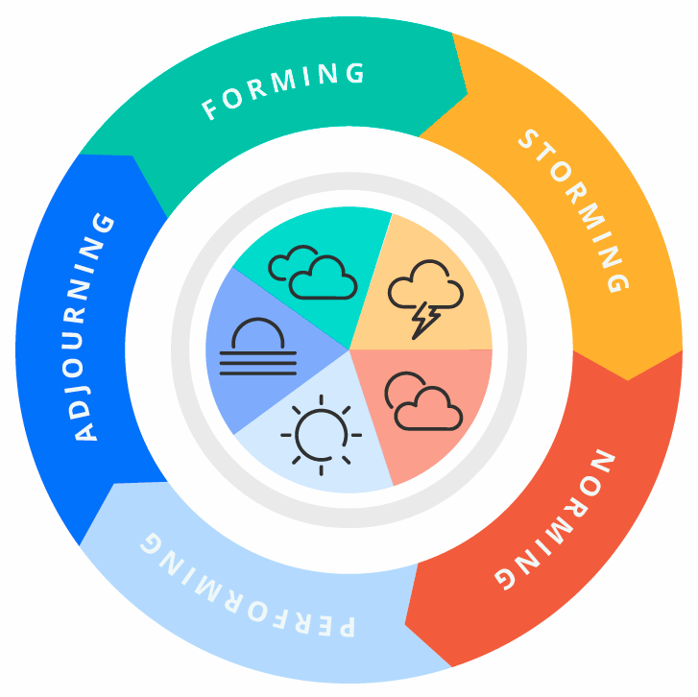
Tuckman’s 5 stages of group development

Slide 10
Stage 1: Forming stage
The first stage of group development is the forming stage. In this stage of group development, individual members are just getting to know each other and don’t have a group process yet. As a result, they're unsure of how they'll interact together. At this stage, the group isn’t very productive, as they're still getting acclimated and figuring out the role that each person will play on the team.
This is a beginning stage and lasts only a few days (or weeks). Members begin by planning their work and their new roles. Moreover, the emotions here are positive. The groups should begin by learning about team processes in preparation for the rough times ahead.

Slide 11
Stage 2: Storming stage
The next stage of group development is the storming stage. In this stage, team members are in the process of learning how to work together. As team members begin collaborating, conflicts may arise, whether that’s from clashing personalities or opinions on how a project should progress.
There exists a considerable amount of fights and arguments in this stage. People begin to feel the stress of frustration, resentment, and anger. Moreover, as the problem festers, the job remains undone.
Managers also experience frustration and are worried about the situation, thereby, are tempted to intervene. Members experience a drastic emotional roller coaster from elation to depression.
Moreover, the situation seems bleak. Usually, the storming period may last 1-2 months. Also, without effective training and support, the team may experience retarded growth.

Slide 12
Stage 3: Norming stage
This is the stage when things begin to settle down as your team finds their groove. As they grow more comfortable working together, team members are more comfortable asking for help completing a task or getting constructive feedback. Your team starts to increase their productivity at this stage as they become more familiar with their teammates and their working styles.
In the norming stage, the group works through individual and social issues. The group establishes its own norms of behaviour and begin to trust each other. Moreover, as the group develops interpersonal skills, it becomes all the more skilled.
Members begin the art and knack of problem-solving. They also cross-train and learn new and adequate job skills. This stage usually lasts for 4-12 months.

Slide 13
Stage 4: Performing stage
:In this stage, the group is ready to begin performing its respective task and assigned jobs. In this stage, the group has become well acquainted with one another and has clarity with regard to what needs to and has to be done. The performing stage begins when the group is comfortable to work and ends when the job is completed.
At this stage, your team has reached cohesion with team processes and team members are working together at their highest potential. Your team follows established workflows to achieve the team’s goals and group members feel as if they have a common goal to reach together. This is the ideal stage of group development. As a team lead, it’s your goal to get your team to this stage as quickly as possible. We discuss more about how to get your team to this point below.

Slide 14
Stage 5: Adjourning stage
Post the performing stage, the group is adjourned. The adjourning stage ends the process of group formation. Because the group is adjourned once the task that is assigned to the group is completed.
The fifth stage of group development, also known as the mourning stage, is the final stage a team will go through. After a project is over or if a team is disbanded, team members who worked together will go into a small mourning period. Group members may have a hard time working with other groups as they had strong group dynamics with their previous team. This is also the time in which teams can celebrate everything they have achieved together. Take the time to reflect on your achievements and remind your team why they’re doing what they do. This is also a great opportunity to recognize and praise the talents of specific team members.

Slide 15
Elements or Properties of Group
1. Role: The role is a set of expected behavior patterns attributed to someone occupying a given position in a social unit.
Role identity: Attitudes and actual behaviors consistent with a role, and they create the role identity. People have the ability to shift roles rapidly where they recognize that a situation and its demands clearly require major changes. For instance, when reunion stewards were promoted to supervisory positions it was found that their attitudes changed from reunion to management within a few months of their promotion. When this promotion had to he rescind later because of economic difficulties in the firm, it was found that the demoted supervisors had once again adopted their pro-union attitude.

Slide 16
Roles Expectation: Roles expectations are defined as the way others believe you should act in a given situation. It can be helpful to look at the topic of role expectations from the perspective of the psychological contract-an unwritten agreement that exists between employees and their employer. If management is derelict in keeping up its part of the bargain, we can expect negative repercussions on employee performance and satisfaction.

Slide 17
Role conflict: When others have different perception or expectations of a person’s role, that person tends to experience role conflict. Such conflict makes it difficult to meet one set of expectations without rejecting another. A company president faced role Conflict, for example, when she learned that both the controller and the personnel director wanted her to allocate the new organizational planning function to their departments.
Role ambiguity: When the role is inadequately defined or is substantially unknown, role ambiguity exists, because people are not sure how they should act in situations of this ^{t}ype. When role conflict and role ambiguity exist, job satisfaction and organizational commitment will likely decline. On the other hand, employees to be more satisfied With their jobs when their roles are clearly defined by job descriptions and statements of performance expectations

Slide 18
2 .Norms: Norms is an acceptable standard of behavior within a group that are shared by the group members. It tells the member what they ought and ought not to do under certain circumstances. From individual sub point, they tell what is expected of you in the certain situation. When agreed to. and accepted by the group, norms act as a means of influencing the behavior of group members with a minimum of external control .norms differ among groups .communities and societies but they all have them.

Slide 19
Common Classes of norms: There are some common classes of norms that appear in the most workgroup. Such as:
Performance norms: Here workgroups typically provide their members with explicit cues on how hard they should work. how to get the job done.
Appearance norms: A second category encompasses appearance norms. This includes things like appropriate dress. loyalty to the workgroup or organization, when to look busy, and when it is acceptable
Arrangement norms: These norms come from informal work groups and primarily regulate social interactions within the group.

Slide 20
3 .Status: The status that is, a socially defined position or rank is given to group or group’s member by others permeates every society. Evan the smallest group will develop roles, rights, and rituals to differentiate its members. Status is an important factor in understanding human behavior because it is a significant motivator and has major behavioral consequences when individuals perceive a. the disparity between what they believe their status to be what others perceive it to be.
4 .Size: The size of a group affects the group’s overall behavior. The impact of size on a group’s performance depends on the type of task in which the group is engaged. In an organization, the group can be formed either large or smaller

Slide 21
Smaller group: In smaller groups- those are faster at completing tasks that are large ones and that individuals perform better in smaller groups than in large ones. Those are better at doing something productive with that input.
Large group: Large groups- those with a dozen or more members- are good for gaining diverse input. So if the goal of the group is fact-finding, large groups should be more effective. However, for groups engaged in problem-solving, large groups consistently get better marks than their smaller counterparts. One of the most important findings related to the size of a group has been labeled social loafing. Social loafing is the tendency for ‘individuals to expend less effort when working collectively when working individually.

Slide 22
5 . Cohesiveness: Group differs in their cohesiveness- that is, the degree to which members are attracted to each other and are motivated to stay in the groups. For instances, some work groups are cohesive because the members have spent a great deal of time together, or the group’s small size facilities high interaction, or the group has experienced external threats that have brought members closer together. Cohesiveness is important because it has been found to be related to group productivity.

Slide 23
Group Decision Making
Because the performance of a group involves taking into account the needs and opinions of every group member, being able to come to an equitable decision as efficiently as possible is important for the functioning of the group. There are a variety of ways to make decisions as a group; the seven-step decision-making model presented below offers an effective structure for choosing an appropriate course of action for a particular task or project. It can also be an effective method for dealing with a problem or interpersonal conflict that arises within the group.

Slide 24
Identify the decision to be made. Before beginning to gather information and list alternatives, it is important for you as a group to understand clearly what you are trying to decide so you have a goal on which to focus your discussions. Potential questions to ask are: What are the particulars of the assigned task? What are we being asked to do? What conflict is affecting our group effectiveness? What barrier to effective group work are we facing?
Analyze the issue under discussion. Once you have defined your goal (i.e., the decision to be made or the problem to be overcome), examine the data and resources that you already have, and identify what additional information you may need. Ask yourselves: What is causing the problem? For whom is this a problem? What is wrong with the current situation? Why do we need to deal with this issue/decision? Where else can we find resources?

Slide 25
3. Establish criteria. Identify the criteria or conditions that would determine whether a chosen solution is successful. Ideally, a solution will be feasible, move the group forward, and meet the needs of every group member. You may want to rank the criteria in order of importance (for example., circumstances may be such that some issues may not be fully resolved). Consider these questions: What would make a solution/decision successful? What issues need to be dealt with in the solution? What criteria will help us determine whether everyone is happy with the solution/decision? Are some criteria more necessary than others?
4. Brainstorm potential solutions. Using the resources and information collected above, brainstorm for potential solutions to the problem or decision identified in step 1. This involves collecting as many ideas as possible. At this stage, ideas should not be criticized or evaluated. Some questions to ask include: What are some possible solutions that would meet most of our established criteria? Are there any options that we may have overlooked? What could we do in the absence of constraints?

Slide 26
5. Evaluate options and select the best one. Once you have a list of potential solutions, you are now ready to evaluate them for the best alternative according to the criteria identified in step 3. Remember that you may be able to combine ideas to create a solution. Ideally, everyone would agree with solution (a consensus), but it's possible that not everyone will. In this case, you will need to use a different decision making methods (see methods in next section). Additional questions to ask when evaluating alternatives are: What are the pros/cons for each option? Which option is the most realistic to accomplish for now? Which option is the most likely to solve the problem for the long-term?
6. Implement the solution. This involves identifying the resources necessary to implement the decision, as well as the potential obstacles, then taking action. Decide: What should be done? How? By whom? By when? In what order?
7. Monitor and evaluate the outcome. Based on the criteria identified in step 3, evaluate whether the decision was successful. If not, revisit step 4 to evaluate the other options or generate new ones

